Slide 1

B.Tech Project Evaluation-2, VIIIth Sem Project Title - Security Wrist Band For Women
Presented by :-
Name- Vareesh Ahmed (2018002828)
Name- Aman Raj (2018002902)
Name- Nadeem Khan (2018008370)
Name- Shubham Saini (2018013926)
Under the Supervision of:-
Dr. Hoor fatima, Asst Professor (CSE)
Sharda University, Gr. Noida
DEPARTMENT OF COMPUTER SCIENCE & ENGINEERING
SCHOOL OF ENGINEERING AND TECHNOLOGY
02, April, 2022
[i]

Slide 2
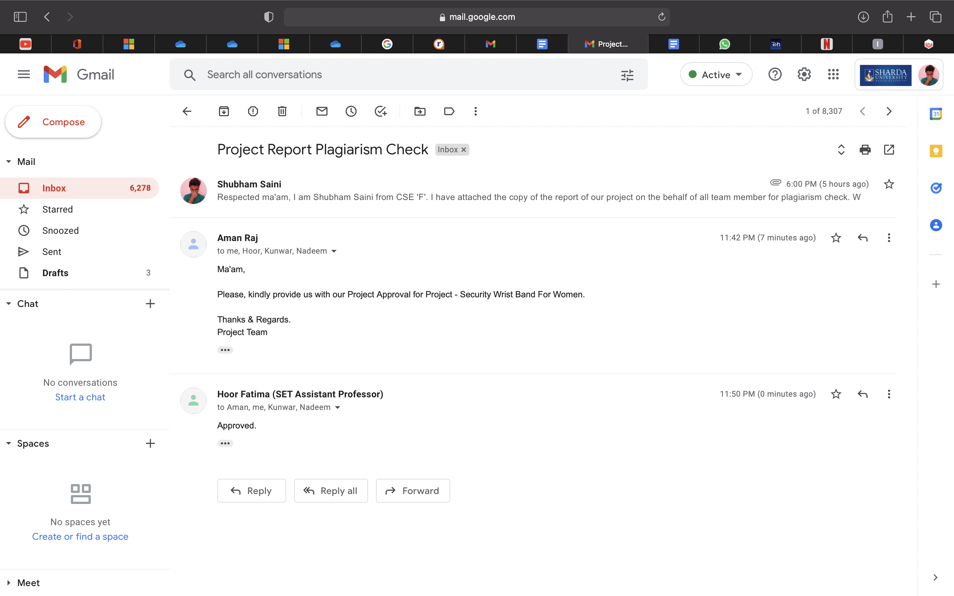
Approval from guide for the evaluation
[ii]

Slide 3
Contents:
Title page ……………………………………………………………………………..……… i
Approval from guide for the evaluation……………………………………………………….ii
Project Overview ………………………..………………………………….…………..……..3
Objective of the Model…………………..…………………………………..….……………..4
Workload Distribution……………………………………….………………….……………..5
Improvement/Work done from the last evaluation……………………..…….………………..6
Proof of paper accepted or communicated/ Hackathon/ Patent………………………………..7
Introduction………………………………………………..…………………………………..8
The Motivation………………………………………….……………………………………..9
Objective of the Model……………………………..…………….……………………..……10
Methodology…………………………………………………………….……………………11
Flow Chart………………………………………..………………….…………….…………15
Feasibility Analysis…………………………………………………………..………………16
Advantages……………………………………………………………….………………..…18
Future Aspects………………………………………………..………….……………….…..19
Conclusion…………………………………………………………….………………..…….20

Slide 4
Project overview:
To plan an encapsulated system for women defense with ability to recognize pulse rate and body temperature and to mark their movement in case of emergencies and will take required actions.
The major objective of the project is to design an IoT system called Smart safety band. Smart Watch contains a layer of sensors that can measure the biological boundaries of women in extreme conditions and 'triggers. Messages to caregivers and the purpose of the project is to design a portable watch to improve the safety of women.
To develop a product based for the emergency security purpose. There are many safety gadgets available in the market for the purpose of emergency safety needs but here our main aim is to propose a security wrist band which will be easily wearable device. Objective of the project is to design small wearable band to enhance the safety of the women.
[3]

Slide 5
Objective of Model
Instant Call for help
Sending alert to required contacts
Instant connection to the nearest police station
Location Sharing
SOS functionality
Sudden Fall Monitor
Oxygen Level (SpO2)
Different Heart Rate Situations
More Accurate of GPS Tracking
Blood Sugar Level (D-Base/Eversense)
GlucoTrack/SugarBEAT
[4]

Slide 6
Improvement/Work done from the last evaluation
Patent and Research Paper has been submitted to the guide for the Approval.
Research Paper 1 related work has been completed as discussed with the guide.
Patent related work is done.
[6]

Slide 7
Proof of paper accepted or communicated/ Hackathon/ Patent
As discussed with the guide we will get the paper published details by 10th of May.
[7]

Slide 8
Introduction
Nowadays, women's safety is changing into a serious matter, such related application do survive, and these square measures fairly good to seize the sufferer mobile.
Here we have a tendency to introduce a smart safety band that provides the Defense of women. This assists to spot the Women that supplicate things to assist from unhealthy things. The system agrees for knowing the exact location of the ladies who have this smart band.
[8]

Slide 9
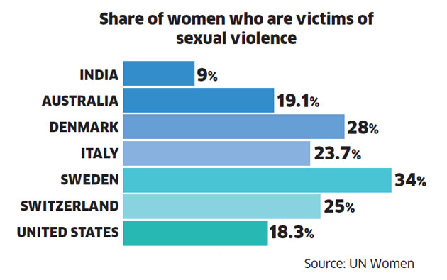
Security Concern
The Motivation
India ranks 148 out of 170 countries in the 'Women, Peace And Security Index 2021'.
Source - Wikipedia
Women Safety
Emergency Help Needed
Notify Family Members
Information Sharing
[9]

Slide 10
Objective of Model
Instant Call for help
Sending alert to required contacts
Instant connection to the nearest police station
Location Sharing
SOS functionality
Sudden Fall Monitor
Oxygen Level (SpO2)
Different Heart Rate Situations
More Accurate of GPS Tracking
Blood Sugar Level (D-Base/Eversense)
GlucoTrack/SugarBEAT
[10]

Slide 11
Working Assets
Methodology
Temperature Sensors - The temperature sensor here used is LM35 series are the temperature devices that produces an output voltage linearly proportional to centigrade temperature.
Pulse-rate Sensor - It uses to measure the nervousness/stress of the person that may have incurred due to the situation. It works by emitting vibrations in the pressure points that we have on our body.
Heart-rate Sensor - it works when a person comes in a situation which deals with anxiety. This sensor measures the heart-rate and sends the signals.
[11]

Slide 12
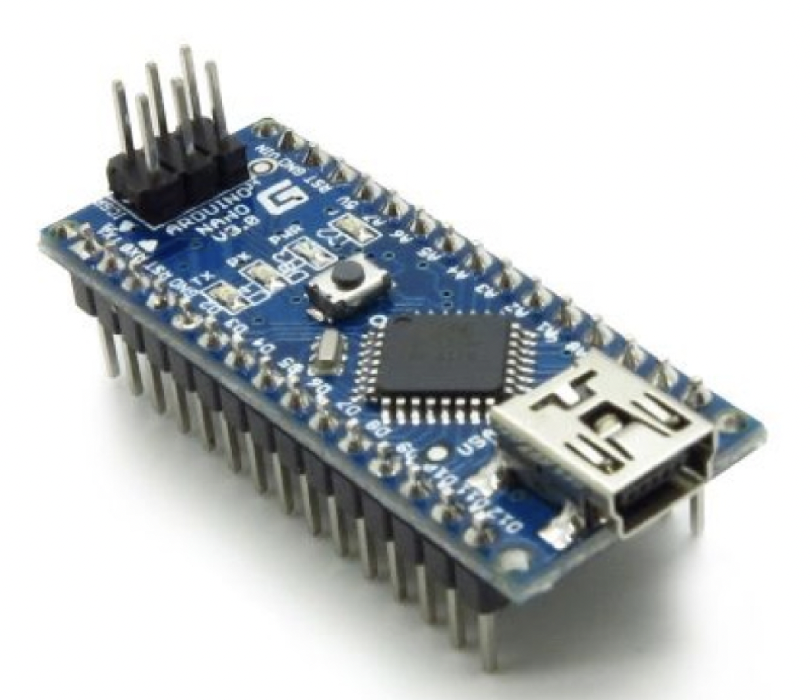
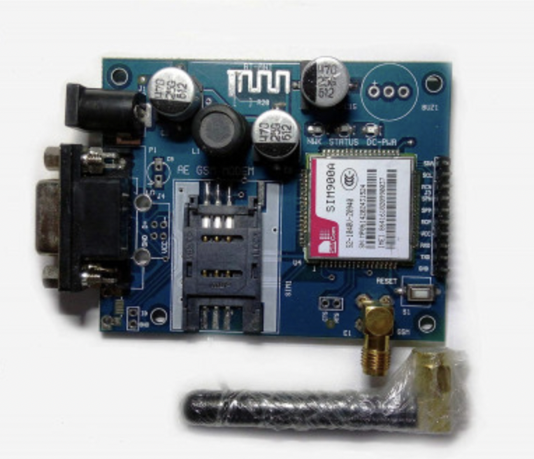
Working Assets cont….
Ardiuno nano - The Arduino Nano is a small, complete, and breadboard-friendly board based on the ATmega32.
GSM Module - A GSM modem or GSM module is a hardware device that uses GSM mobile telephone technology to provide a data link to a remote network.
[12]

Slide 13
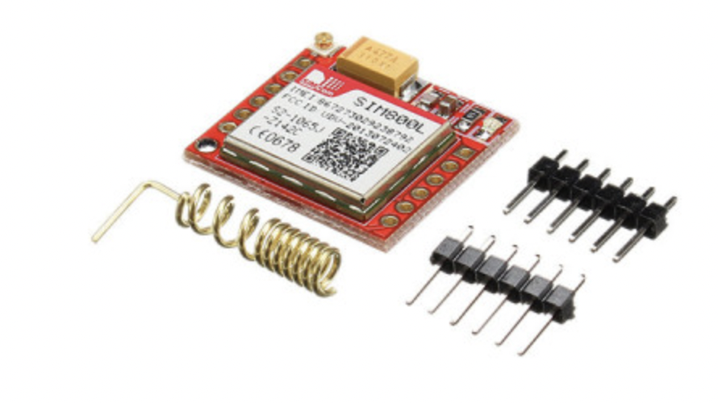
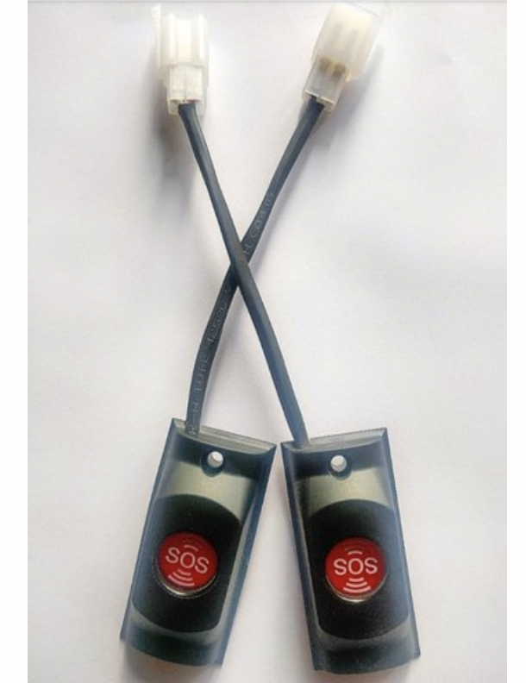
Working Assets cont….
GSM Sim Tool - SIM Application Toolkit (STK) is a standard of the GSM system which enables the subscriber identity module (SIM card) to initiate actions which can be used for various value-added services.
SOS Switch - The SOS button linked to eCall, the eCall system automatically notifies the emergency services if your car is involved in an accident.
[13]

Slide 14
Working Assets cont….
Pulse Rate Sensor - It is an optical heart rate sensor measures pulse waves, which are changes in the volume of a blood vessel that occur when the heart pumps blood.
Temperature Sensor - A temperature sensor is a device used to measure temperature. This can be air temperature, liquid temperature or the temperature of solid matter.
Wrist Band - Wristbands are encircling strips worn on the wrist or lower forearm, the term can be used to refer to a bracelet-like band.
2 x 9V Cells - The nine-volt battery, or 9-volt battery, is a common size of battery that was introduced for early transistor radios. It has a rectangular prism shape with rounded edges and a polarized snap connector at the top.
[14]

Slide 15
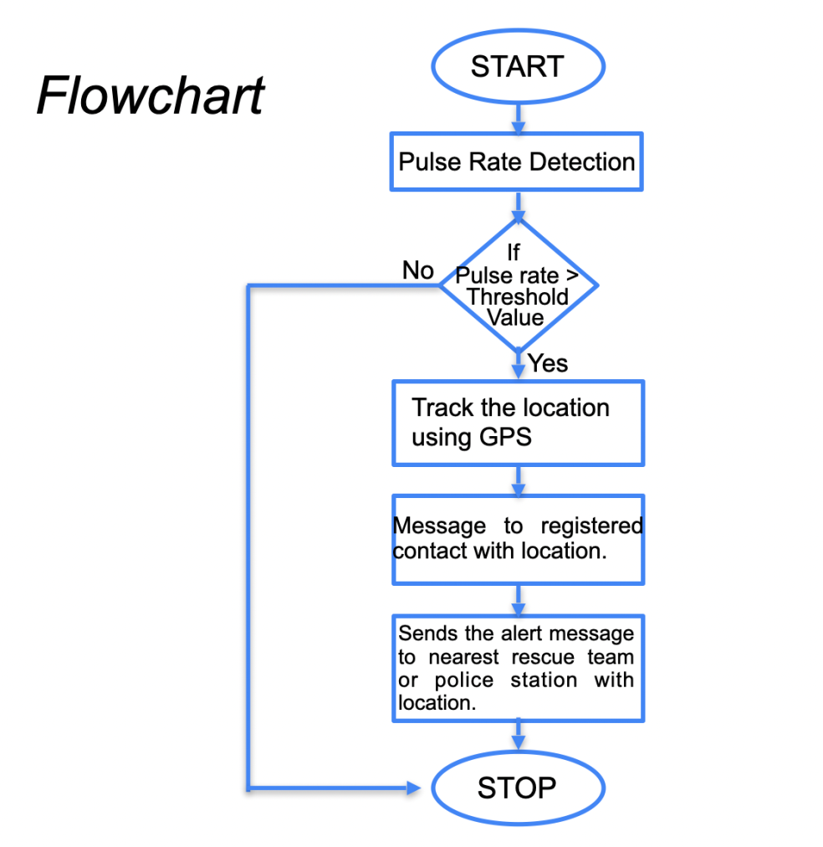
Flow Chart
[15]

Slide 16
Feasibility Analysis
Economic Feasibility:
As this IoT based project has been made through considering the cost, anyone can buy it easily.
According to our understanding, it will have an overall cost of Rs 3500 only.
The features that, it provides at this price range is amazing and hence it is pocket friendly too.
Maintenance and repairing will have very minimal associated cost.
User will experience many benefits at a very low cost.
Technical Feasibility:
Ardiuno Nano.
GSM Module.
GSM Sim Tool.
SOS Switch.
Pulse Rate Sensor.
Temperature Sensor.
Wrist Band.
2 x 9V Cells.
These tools are very efficient and are easily available.
[16]

Slide 17
Feasibility Analysis cont…
Resource Feasibility:
Programming Device such as Laptops.
Wrist Bands that is easily available.
9V Cells that we can get at any nearby store.
Ardiuno nano, which we can easily buy from any online store.
Time Feasibility:
The time period for this project is provided by the mentor.
This project will have several deadlines and deliverables that are schedules successively.
Each part of the project has a deadline time to complete which makes this project time efficient.
Hence, the development of the complete project is well planned and no delays expected resulting in a timely completion.
[17]

Slide 18
Advantages
Cost Effective - Use of low-cost hardware providing most accurate results will be considered.
Reliable - The proposed wrist band would be of high reliability as it will be of high quality and flexibility so that user can use it properly.
Security - We will be able to connect or locate the person using GPS coordinates and can be able to sense increased heart-rate during panic situations and so it can be used in a situation that requires immediate action.
Maintainability - It takes less time to perform a successful repair action. It will measure the ease and speed with which the wristband will get restored when got defected.
[18]

Slide 19
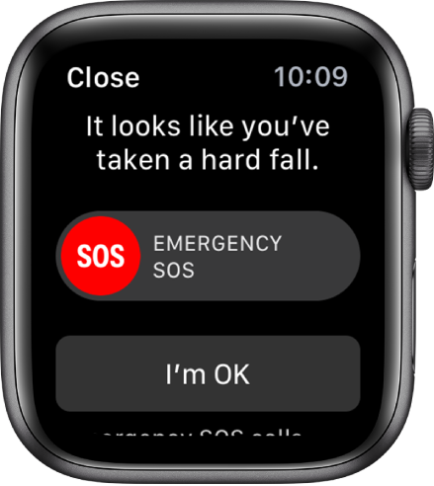
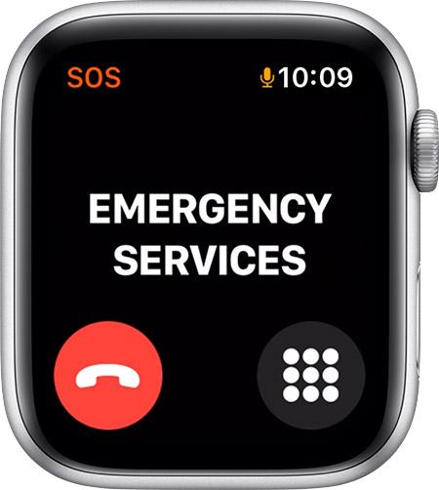
Future Aspects
[19]

Slide 20
Conclusion
This device represent concerning the important problems in the society that is faced by the ladies nowadays and can ease to resolve them technologically with compress instrumentality and concepts. Exploitation articulatio wrist band and spectacles, screaming alarms, live streaming video and additionally alerting the emergency connections by causation the texts with the location. This method will get the better of the Concerns that fears every girl within the nation concerning her safety and security.
We will be able to connect or locate the person using GPS coordinates and can be able to sense increased heart-rate during panic situations.It can be used in a situation that requires immediate action and so it will help us to improve the individual’s security.
[20]

Slide 21
Thank You !

